Slide 1

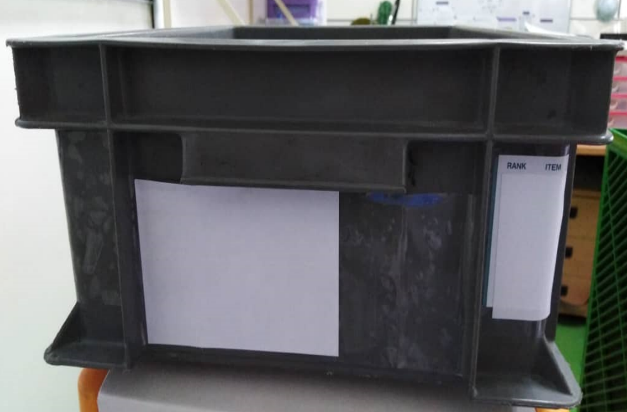
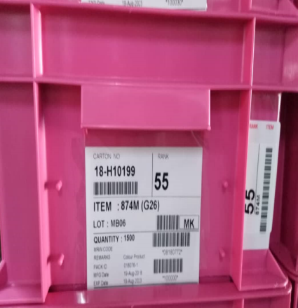
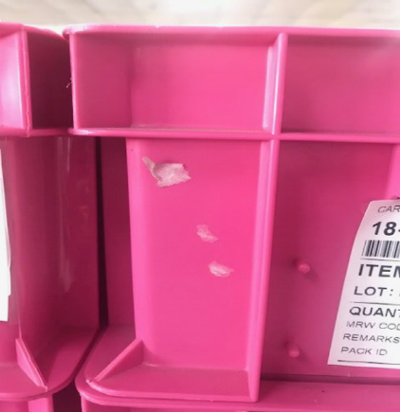
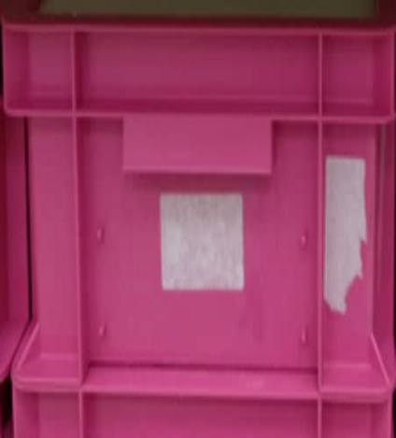
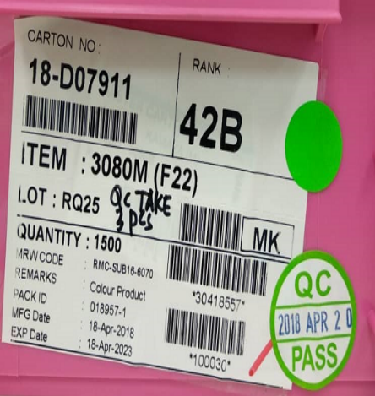
GRAY/PINK BOX DIRTY IMPROVEMENT
Customer Claim | Countermeasure
No space for IQA Sticker so customer paste on left side area not on cellophane tape cause dirty when label were tear off
Label on center, no space for IQA sticker
Label paste on left side or not on cellophane tape cause label dirty
No space for IQA sticker
Carton label paste on left side create space on right side for IQA sticker can be paste on cellophane tape.
DON’T paste label/sticker on left/right/back side which not cover with cellophane tape.
Please store gray/pink box on warehouse or storage area. DON’T put outside cause wet, dirty and dust.
Label paste left/right/back side or not on cellophane tape cause label dirty
Prepared by : Rosli Ahmad

